Slide 1

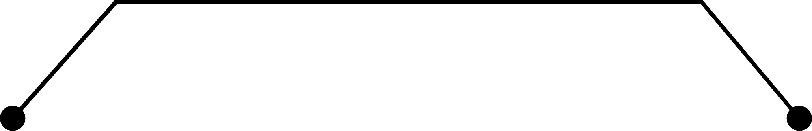
Smart Farm IoT : Revolutionizing Agriculture
Through Connected Sensor Technology
Presented by : Deepak Mehra
MIS NO : 222416002
Branch : ECE
Project Supervisor: Dr. Dipen Bepari

Slide 2
INTRODUCTION
This smart farm project focuses on using IoT technology in agriculture to improve efficiency and productivity.
In IoT connects devices like soil moisture sensors, temperature monitors, and light detectors to provide real-time data for better farming decisions.
The system automates processes such as irrigation and fertilization, reducing waste and saving resources like water and energy.
It helps farmers manage crops more effectively, improve yields, and adopt sustainable farming practices.
This approach addresses challenges like climate change, food security, and resource scarcity.
By integrating advanced technology, smart farming aims to make agriculture more productive, efficient, and eco-friendly.

Slide 3
MOTIVATION
Traditional farming methods waste resources and struggle with unpredictable climate, making it hard to meet global food needs.
There is an urgent demand for smarter farming methods that save resources like water and energy while increasing productivity.
Smart farming uses IoT technology (connected sensors) to monitor factors like soil and weather in real-time, helping farmers make better decisions.
Automated systems for irrigation and fertilization save water, reduce waste, and require less labor.
These technologies aim to boost crop health and yield while addressing global challenges like food security and climate change.

Slide 4
Literature survey
SR. NO | Title Of Paper | Journal/ Conference Name And Year | Author | Key points | Challenges/Remarks
1 2 | Building an Automatic Irrigation Fertilization System for Smart Farm in Greenhouse. A novel model for optimization of resource utilization in smart agriculture system using IoT (SMAIoT). | IEEE Publication Journal vol. 70, no. 2, pp. 4685-4698, May 2024 IEEE Internet of Things Journal, 9(13), 11275-11282,(2021). | Duy Thanh Tran , Hoanh Su Le , and Jun-Ho Huh Jani, K. A., & Chaubey, N. K. | The system utilizes sensors to monitor soil moisture levels and automatically adjust water flow, ensuring optimal irrigation for plants in the greenhouse. The system incorporates a fertigation module, delivering the right amount of fertilizer based on soil nutrient levels, promoting healthy plant growth. The system uses IoT sensors to track soil moisture, weather, and crop health for better resource management. It employs real-time data analysis to optimize water usage, fertilizer application, and energy consumption. The system automates irrigation and other farming tasks, reducing waste and improving productivity. | Ensuring the sensors accurately detect moisture and nutrient levels in real-time can be difficult, affecting system efficiency. Linking irrigation and fertilization systems with temperature and humidity control can be complex but essential for optimal crop growth. Data Overload Managing the massive amounts of data generated by IoT devices in real time for efficient decision making. Energy Efficiency Ensuring that IoT devices in the system consume minimal energy while maintaining performance. Ensuring stable and continuous communication in remote areas can be difficult, leading to potential system failures.

Slide 5
Literature survey
SR. NO | Title Of Paper | Journal/ Conference Name And Year | Author | Key points | Challenges/Remarks
3 4 | Smart Farming Systems Using IoT and Cloud Technologies. Internet of Things (IoT) for smart precision agriculture and farming in rural areas. | IEEE Internet of Things Journal, 7(2), 1100-1115, (2020). IEEE internet of things journal, 5(6), 4890-4899, (2018). | Smith, J., & Kumar, R. Ahmed, N., De, D., & Hussain, I. | The integration of IoT and cloud technologies in smart farming significantly improves crop monitoring, resource management, and overall productivity. IoT-based systems optimize the usage of water, fertilizers, and energy, reducing operational costs while maintaining sustainable farming practices. IoT enables precise monitoring and automation of farming activities, optimizing resource use like water, fertilizers, and pesticides. Real-time data from IoT sensors helps farmers make informed decisions, increasing crop productivity and reducing losses. | Connectivity and Data Transmission In smart farming, reliable connectivity is often a problem, as many rural areas lack stable internet access, making data transmission difficult. Data Security and Privacy As farms collect a lot of sensitive data, ensuring secure cloud storage and protecting against cyberattacks are significant concerns. Many rural areas lack reliable internet, making it hard to use IoT devices and their maintenance can be expensive for small farmers. Farmers may need training to use and manage IoT technologies properly. The unreliable internet connectivity, hindering real-time data transmission and system efficiency. Additionally, the high upfront costs of IoT infrastructure can be a barrier for small-scale farmers.

Slide 6
Literature survey
SR. NO | Title Of Paper | Journal/ Conference Name And Year | Author | Key points | Challenges/Remarks
5 6 | IoT in agriculture: challenges and opportunities. Sensor-Based Automated Irrigation Systems in Smart Farming. | IEEE Journal of Agricultural Research (03681157), 59(1), (2021) International Journal of Agricultural Innovation and Research, 9(3), 12-25,(2020). | Farooq, M. S., & Akram, S. Chaudhary, V., & Patel, M. | IoT in agriculture faces obstacles such as limited internet connectivity in rural areas and high costs of implementation. It enables precision farming, real-time monitoring, and improved resource efficiency, driving sustainable agricultural practices. Sensor-based irrigation systems monitor soil moisture and weather conditions, ensuring water is used only when needed, reducing waste. Automation These systems automatically control irrigation based on real-time data, saving farmers time and effort. Improved Crop Health By providing precise water levels, the system helps crops grow better, boosting yield and quality. | Many rural areas lack stable internet, making it hard for IoT devices to work efficiently. The price of IoT devices and maintenance can be too expensive for small farmers. Farmers worry about their data being hacked or misused. Setting up sensor-based systems can be expensive, especially for small-scale farmers. Farmers may face difficulties in using and maintaining the advanced technology. Reliable internet or network access is often needed, which might not be available in remote areas.

Slide 7
Literature survey
SR. NO | Title Of Paper | Journal/ Conference Name And Year | Author | Key points | Challenges/Remarks
7 8 | Role of Cloud Analytics in IoT-Based Precision Farming. Improving Crop Yield with IoT-Based Smart Fertilization Systems. | Agriculture and Big Data Journal, 5(1), 30-42,(2023). Agriculture Technology Review, 11(6), 78-92,(2022). | Kaur, S., & Singh, J. Tran, N., & Le, T | Data Storage and Processing Cloud analytics enables the storage and processing of large volumes of data from IoT sensors, allowing farmers to access insights remotely and in real time. Predictive Insights By analyzing data from IoT devices, cloud analytics helps in predicting crop health, weather patterns, and optimal irrigation schedules, improving farm productivity and efficiency. IoT systems monitor soil and plant health, delivering fertilizers only where needed, improving crop yield while reducing waste. Sensors track environmental conditions like moisture and temperature, allowing for timely anaccurate fertilization adjustments. Using smart systems reduces overuse of fertilizers, conserving resources and minimizing environmental impactd. | The vast amount of sensitive data collected by IoT devices can be vulnerable to cyber-attacks or unauthorized access, requiring strong security measures. Integrating data from various IoT sensors and ensuring its accurate processing and management in the cloud can be complex, requiring efficient systems for real-time analysis. Ensuring sensors provide reliable data for precise fertilizer application can be difficult due to environmental factors. High initial setup costs and ongoing maintenance of IoT devices can be a barrier for farmers. Combining new IoT technologies with traditional farming methods may require significant adjustments and training.

Slide 8
Literature survey
SR. NO | Title Of Paper | Journal/ Conference Name And Year | Author | Key points | Challenges/Remarks
9 10 | IoT-based crop health monitoring using AI. IoT-based intelligent irrigation support system for smart farming applications. | Journal of Smart Agriculture Systems, 5(4), 198-211,(2021). Adv. Distrib. Comput. Artif. Intell. J., 8(2), 73–85,(2019) | Ahmed, A., & Rahman, M. Nawandar, N. K., & Satpute, V. | IoT sensors to collect real-time data on soil, weather, and crop conditions, improving farm management. AI algorithms analyze the collected data to detect crop diseases, pests, or nutrient deficiencies quickly and accurately. The system provides farmers with actionable insights and recommendations to optimize crop health and yield. The system uses IoT devices like sensors and controllers to monitor soil moisture, weather, and crop health in real-time. Automated irrigation is triggered based on sensor data, ensuring efficient water usage without manual intervention. The system collects data for analysis to optimize irrigation schedules, improve crop yield, and conserve water. | Ensuring the sensors provide precise data in diverse environmental conditions. Handling large amounts of real-time data and making quick, accurate predictions. Maintaining reliable communication between sensors and central systems, especially in remote areas. Ensuring the sensors provide accurate data for proper irrigation decisions is challenging due to environmental factors. Reliable communication between devices can be disrupted by weak network signals in remote farming areas. Maintaining low energy usage while ensuring continuous operation of IoT devices in the field is a key challenge.

Slide 9
Research Gap
Current IoT systems are limited to specific crops or regions and struggle with integrating diverse devices and platforms effectively.
Insufficient network infrastructure, especially in rural areas, hampers real-time data transmission and system efficiency.
High initial setup costs for IoT-based solutions deter adoption, particularly among small-scale farmers.
Existing systems lack optimized energy solutions, which is critical for remote farming areas.
Limited research exists on how IoT affects soil health, biodiversity, and the socio-economic welfare of farmers over time.

Slide 10
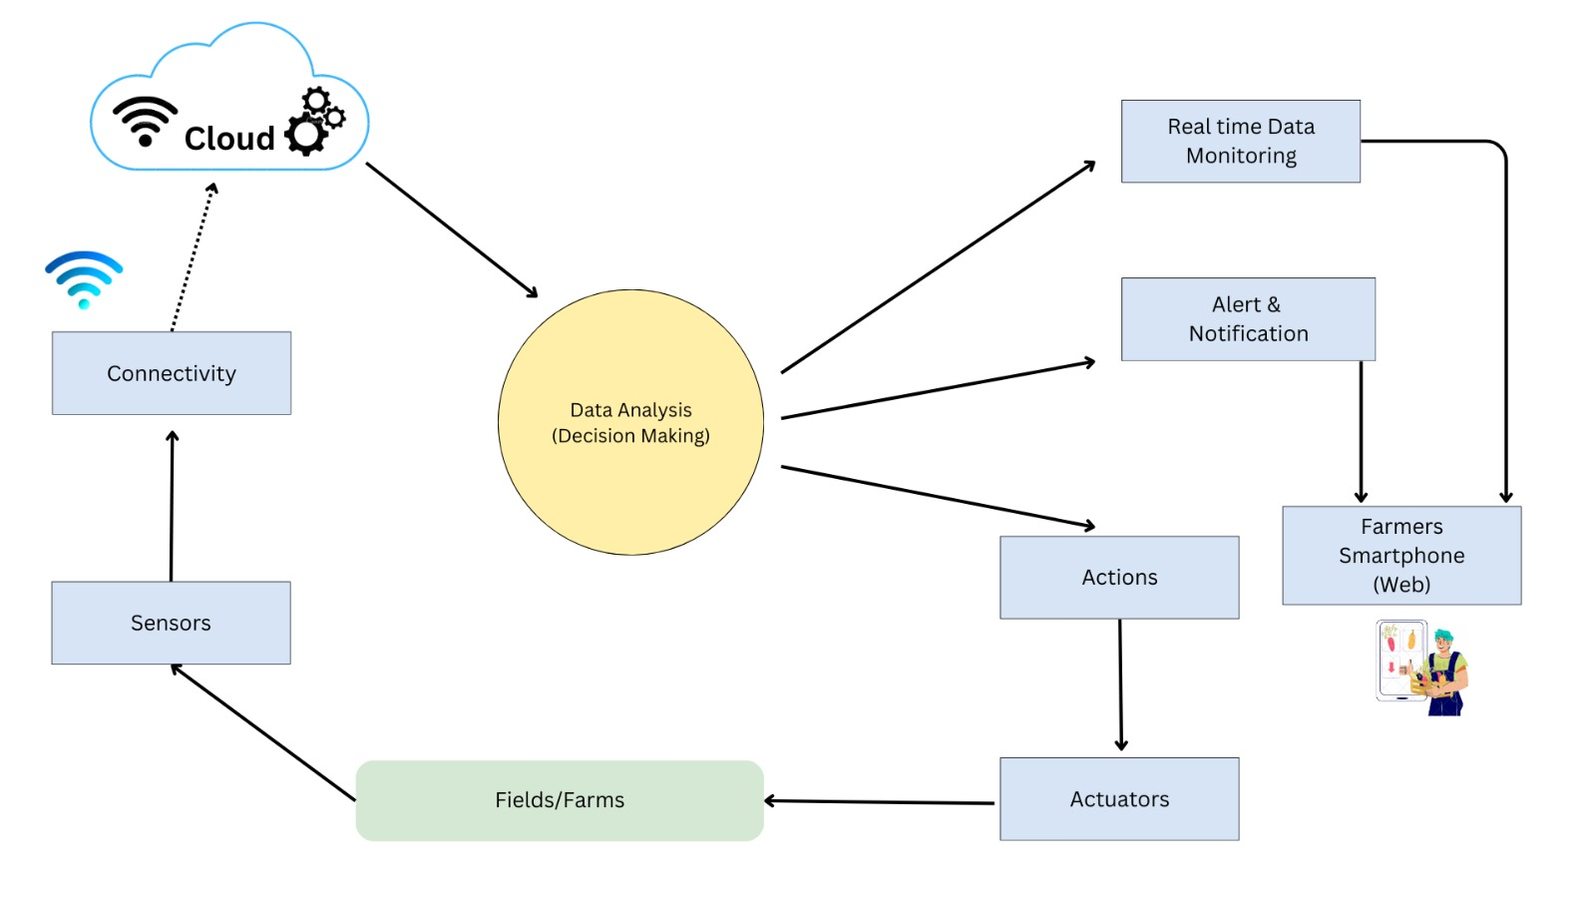
Methodology
Fig 1 : Model Flow chart

Slide 11
Technology Used
Component | Technology | Purpose
Soil Moisture Sensor | Capacitive/Resistive Sensors | Measures soil moisture levels to optimize irrigation.
Temperature Sensor | Digital Thermistor | Monitors environmental temperature for crop health.
Humidity Sensor | Capacitive/Resistive Sensors | Tracks air humidity levels for ideal growing conditions.
pH Sensor | Ion-selective Electrodes | Determines soil acidity or alkalinity for crop suitability.
Irrigation System | Solenoid Valves, Pumps | Automates water supply based on soil moisture data.
Fertilization System | Fertilizer Pumps and Valves | Automates nutrient delivery based on crop requirements.

Slide 12
Technology Used
Component | Technology | Purpose
Controller | Microcontroller (e.g., Arduino, Raspberry Pi) | Processes data and triggers automation systems.
Communication Module | Wi-Fi, Zigbee, LoRa | Enables real-time data transmission between components and cloud.
Cloud Platform | AWS IoT, Google Cloud IoT | Stores and analyzes historical and real-time data for decision-making.
User Interface | Web/Mobile App | Provides system status, alerts, and manual control for farmers.
Power Supply | Solar Panels, Batteries | Ensures continuous power supply in remote farming areas.
Table: 1 Technology Used

Slide 13

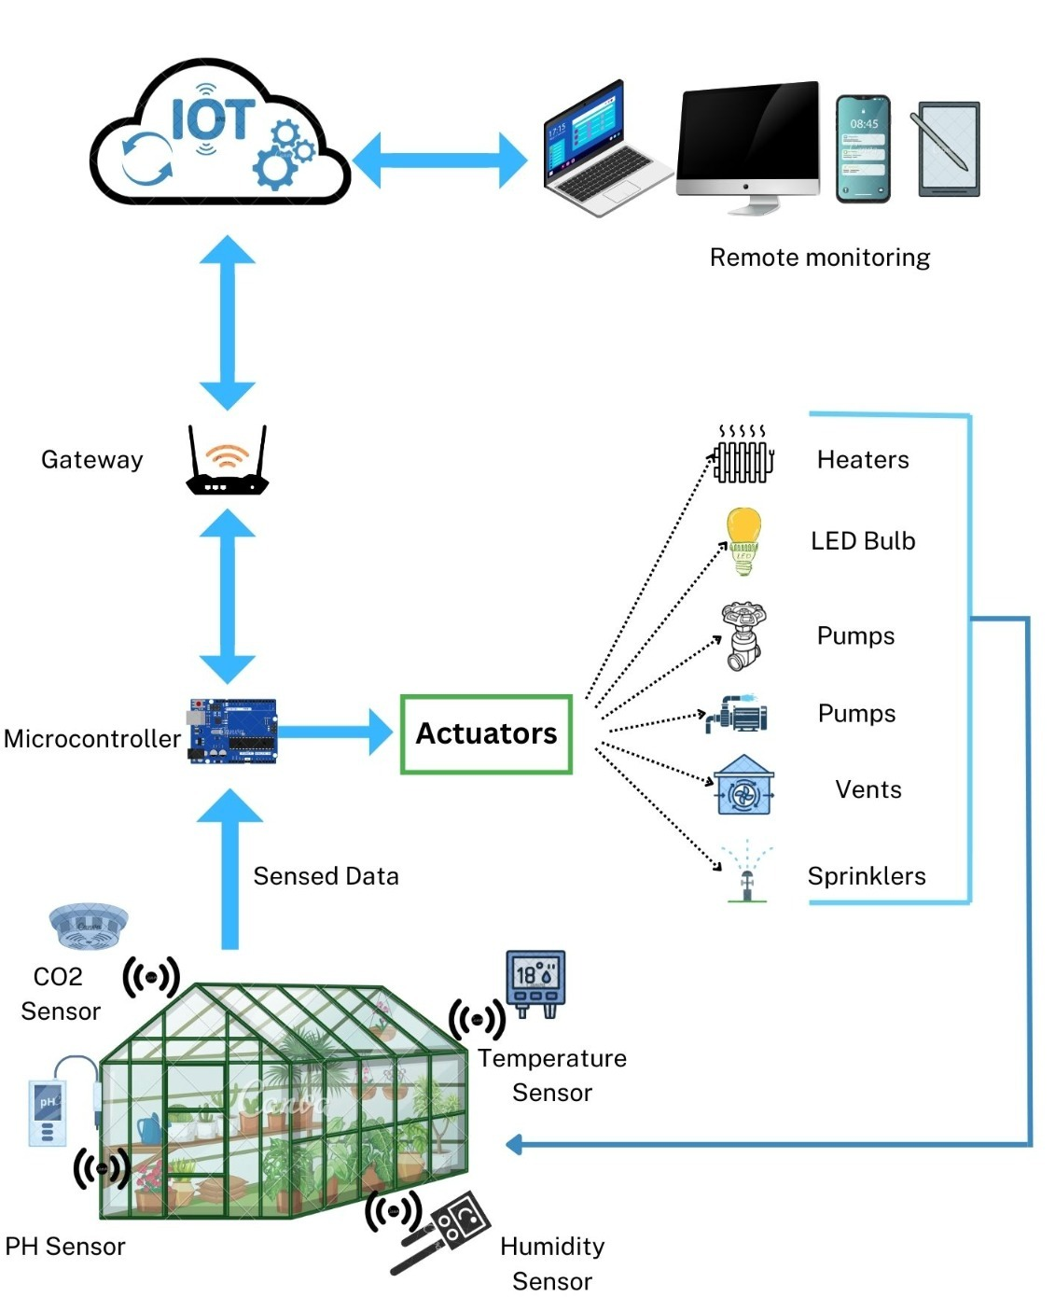
System Architecture
Technology Used
Sensor Layer: Collects environmental data such as soil moisture, temperature, humidity, and light intensity.
Communication Layer: Transmits collected data using wireless technologies like LoRa, Wi-Fi, or GSM.
Processing Layer: Analyzes real-time data with microcontrollers or edge computing devices and generates actionable insights.
Cloud Integration: Stores, analyzes, and visualizes data for predictive analytics and remote monitoring.
Automation Layer: Executes irrigation and fertilization based on thresholds and decision algorithms.
User Interface: Provides farmers with a dashboard or mobile app for monitoring, controlling, and receiving system alerts.
Fig.2 System Architecture

Slide 14
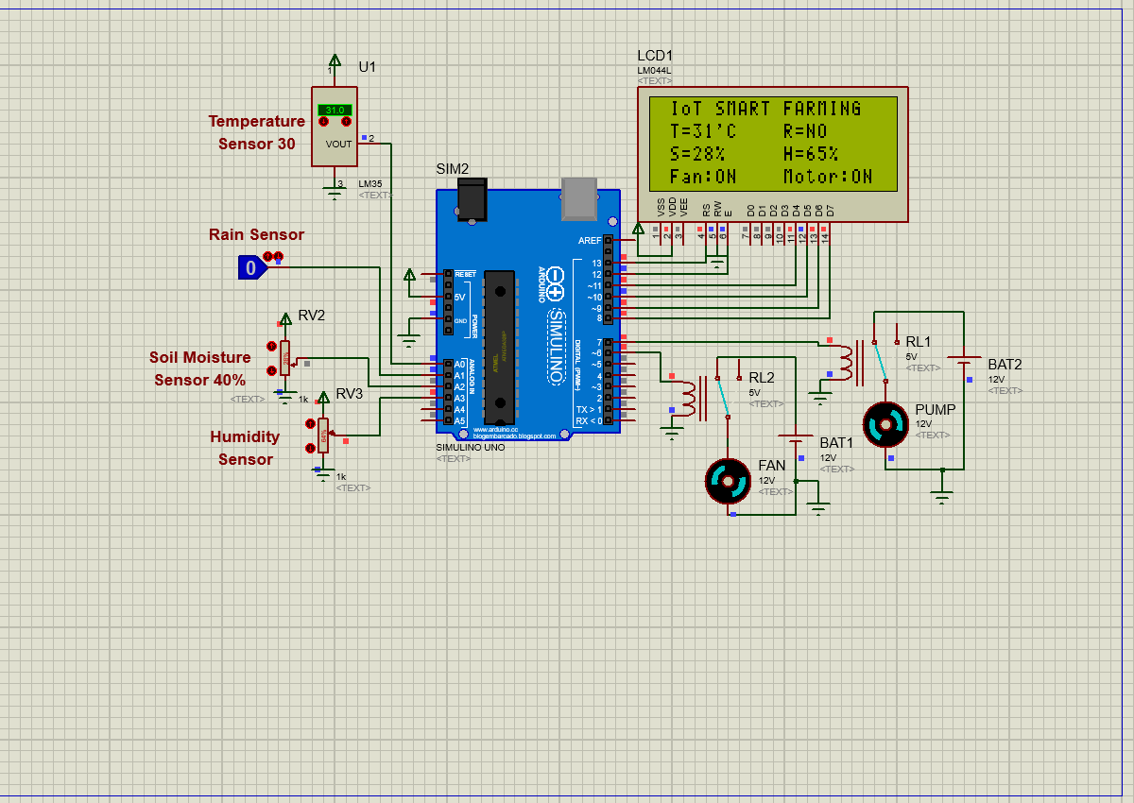
Result
Fig.3

Slide 15
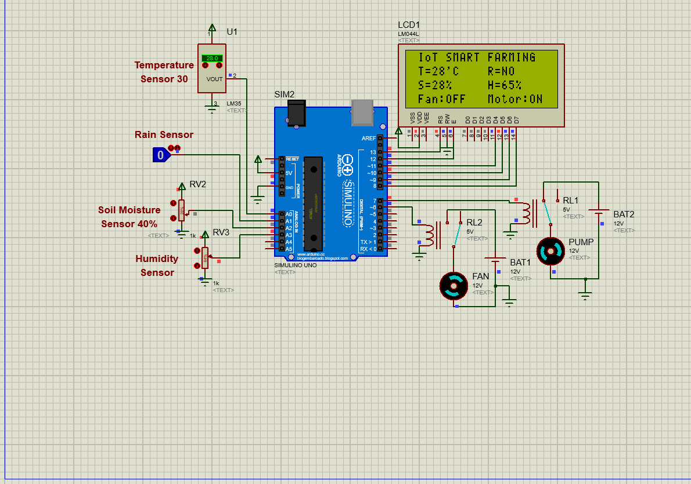
Result
Fig.4

Slide 16
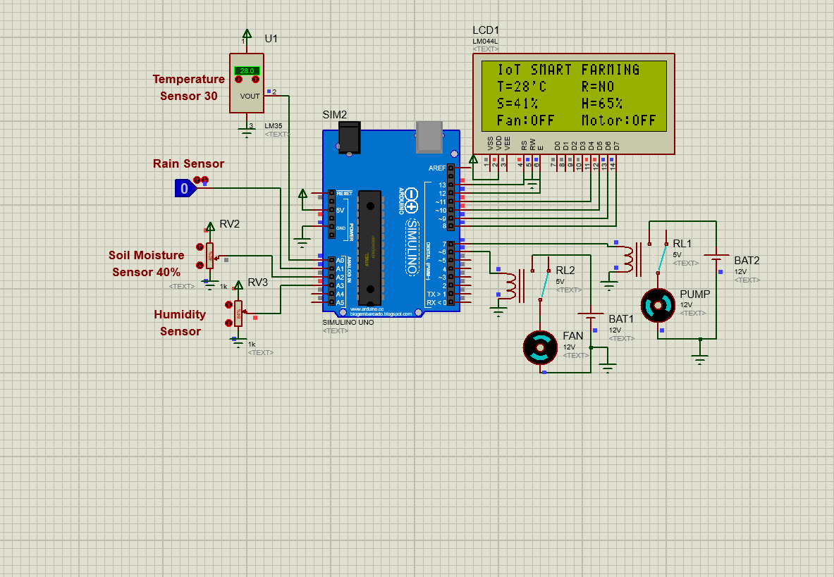
Result
Fig.5

Slide 17
Conclusion
The Smart Farming IoT system optimizes water and fertilizer usage, reducing waste by up to 30% and improving crop yields.
Automated processes like irrigation and fertilization lower labor demands, making farming more efficient and sustainable.
Real-time data and an intuitive interface empower farmers to make informed decisions, enhancing agricultural practices.
The system supports sustainable farming by conserving resources, reducing environmental impact, and improving farm profitability.
Although challenges like high costs and rural connectivity issues remain, this system holds immense potential to modernize agriculture globally.

Slide 18
References
[1].Duy Thanh Tran , Hoanh Su Le , and Jun-Ho Huh (2024). " Building an Automatic Irrigation Fertilization System for Smart Farm in Greenhouse" IEEE Publication Journal vol. 70, no. 2, pp. 4685-4698.
[2].Smith, J., & Kumar, R. (2020). "Smart Farming Systems Using IoT and Cloud Technologies." IEEE Internet of Things Journal, 7(2), 1100-1115.
[3].Brown, T., & Lee, H. (2022). "Sustainable Farming Practices Enabled by IoT-Based Solutions." Journal of Sustainable Agriculture, 10(4), 234-245.
[4].Wu, Y., & Zhang, Q. (2021). "Precision Agriculture Using IoT: A Comprehensive Review." Computers and Electronics in Agriculture, 190, 106-123.
[5].Dhingra, N., & Gupta, A. (2022). "IoT-Enabled Decision Support Systems for Smart Greenhouses." Smart Systems and Agriculture Journal, 14(5), 456-470.
[6].Chaudhary, V., & Patel, M. (2020). "Sensor-Based Automated Irrigation Systems in Smart Farming." International Journal of Agricultural Innovation and Research, 9(3), 12-25.
[7].Kaur, S., & Singh, J. (2023). "Role of Cloud Analytics in IoT-Based Precision Farming." Agriculture and Big Data Journal, 5(1), 30-42.
[8].Tran, N., & Le, T. (2022). "Improving Crop Yield with IoT-Based Smart Fertilization Systems." Agriculture Technology Review, 11(6), 78-92.
[9].Ahmed, A., & Rahman, M. (2021). IoT-based crop health monitoring using AI. Journal of Smart Agriculture Systems, 5(4), 198-211.
[10].Nawandar, N. K., & Satpute, V. (2019). IoT-based intelligent irrigation support system for smart farming applications. Adv. Distrib. Comput. Artif. Intell. J., 8(2), 73–85.

Slide 19
1
THANK YOU

